Slide 1
How to achieve flexibility in accordance with the Czech Labour Code
Arthur Braun, M.A.
JUDr. Lucie Kalašová, LL.M.
20th November 2020
商工会会員様宛配信：11月例会（11/20）開催のご案内

Slide 2
Content
Identify your needs and limitations
Shifts
Distribution of working hours
Limitations – mandatory rest
Avoid unnecessary limitations
Overtime
Changes to Labour Code 2021
Some simple things
Kurzarbeit
Employment agencies (in Czech: agentury práce)
Work contracts
Conclusion
Contact
About bpv BRAUN PARTNERS / bpv LEGAL
Rankings

Slide 3
Identify your needs and limitations
There is no simple solution that is the best
for all employers and their employees
Identify
employer’s needs employer’s limits (production managers) (HR manager, lawyer)
Find a solution
Czech Labour Code, EU directives and court decisions, collective bargaining agrements, Internal Rules, individual contracts, practice)

Slide 4
Shifts
Max. duration of one shift = 12 hours
1 shift: 40 hours per week
2 shifts: 38.75 hours per week
3+ shifts: 37.5 hours per week
Split shifts
First part of the shift Free time Second part of the shift
(not included in the working hours)

Slide 5
Distribution of working hours
Distribution of working hours:
Evenly (in Czech rovnoměrně) – the same number of working hours each week, individual shifts can vary
Unevenly (in Czech nerovnoměrně) – different number of working hours each week, individual shifts can vary
Compensatory period up to 26 weeks (in collective agreement up to 52 weeks)
Account of Working Hours (in Czech: Konto pracovní doby)
Payment of at least 80% average salary
Employers must keep a salary account and working time account for each employee – adminsitratively demanding
Still same limitations 26/52 weeks as other models
Flexible working hours (in Czech: pružná pracovní doba)
Suitable for white-collar workers, compensatory period up to 26 weeks (in collective agreement up to 52 weeks)
The employer must determine 3 time periods:
optional working hours basic working hours optional working hours

Slide 6
Limitations – mandatory rest
Continuous rest between two shifts
Distribution of working hours so that the employee can rest without interruption for a period of at least 11 hours within 24 consecutive hours between the end of one shift and the beginning of the next shift;.
Uninterrupted rest during the week
Distribution so that the employee can rest without interruption during the week for a period of at least 35 hours.
Break for lunch and rest
Break for lunch and rest of at least 30 minutes after no more than six hours of continuous work; for a minor, this break must be provided after no more than 4.5 hours of continuous work. Break for lunch is not included in the working hours.
For work that cannot be interrupted, the employee must be provided with an appropriate period of time for rest and lunch, even without interrupting the operations or work; this period is included in the working hours.
In addition: safety breaks
Depend on the specific work performed, often in CBAs

Slide 7
Avoid unnecessary limitations
How do employers limit themselves without reason?
By making long employment agreements with many unnecessary clauses, which change the character of the employer’s original unilateral rights into an agreement that cannot be changed without the employee’s consent (for example detailed descrition of the type of the work/job position, distribution of working hours, working time (start and end of the shift), vacation days over the limit stipulated by the law, sick days).

Slide 8
Overtime
Limits given by Czech law and EU directive
2 types:
Ordered overtime (8 hours/per week, 150 per calendar year)
Only with employee’s consent (8 hours per week on average, compensatory time period 26 weeks/52 weeks)
Consent can be a standard clause in your employment agreement
Payment
Included in monthly salary (normal employees up to 150 overtime hours per calendar year, managers up to 416 overtime hours per calendar year). In practice mostly for white-collar
Paid separately, preference by law for payment (salary +25% surcharge)
Overtime work cannot be planned in the shift plan!
Part-time workers
Extra shift as overtime work?
2nd employment with same employer?

Slide 9
Changes to Labour Code 2021
Job sharing
Will not help in terms of employer’s flexibility as it is limited to full-time weekly working hours
Helps employee achieve work/life balance
It is easy to terminate job sharing cooperation but not employment!

Slide 10
Some simple things
Probation period (3 or 6 months)
Start with limited time contracts – can be repeated twice (in theory up to nine years)
Make larger chunk of salary as variable
Possibility to send employee to other employers (in Czech: dočasné přidělení mezi zaměstnavateli) if in accordance with contract (description of work and place of work, not earlier than after 6 months from the day of commencement of the employment ) and employee agrees. Equal Treatment, no profit to be gained. But no license necessary.
Employing part-timers (up to 50%) under agreement on work activity (in Czech: Dohoda o pracovní činnosti, DPČ). Advantages among others only 2 weeks notice period, no severance payment

Slide 11
Kurzarbeit
Partial unemployment (in Czech: částečná nezaměstnanost)
if the employer is unable to assign work to the employee within the scope of the weekly working hours on the grounds of temporary limitation of sales of products of the employer or limitation of demand for services provided by the employer
salary compensation must not be less than 60 per cent of the average earnings;
agreement with trade unions x if there is no trade union at the employer, such agreement may be replaced with an internal regulation.
Following Antivirus (extended until 31 December 2020): starting probably 2021 as proposed by government

Slide 12
Employment agencies (in Czech: agentury práce)
Remuneration payment for the agency is not the employee’s salary (cost of labour increases)
Be careful:
What you pay for!
Best solution: user pays only for work performed
About termination reasons! It is not to the user’s advantage if they are limited only to the termination reasons in Section 52 of the Czech Labor Code
Always check the agency’s license!
https://www.uradprace.cz/web/cz/agentury-prace
Check details in the license as well
(such as types of work permitted)

Slide 13
Work contracts
Outsourcing services in your premises
Risks:
Illegal work (foreigners from third countries, „švarc systém“)
Agency employment without a license and connected obligatory written agreement
Legal penalties:
Illegal work CZK 50,000 – 10,000,000
Missing written agreement – up to CZK 1,000,000

Slide 14
Conclusion
The Czech employment law offers more possibilities than you think to reach flexibility.

Slide 15
Contact
Arthur Braun is Managing Partner of the law firm bpv BRAUN PARTNERS and head of the M&A team. In addition, he also focuses on corporate and commercial law, competition law, labour law and inbound investments in the Czech Republic and Slovakia. Throughout his practice, he has taken part in hundreds of transactions and greenfield investments by international and domestic clients.
The prestigious international rating publications Chambers Europe, European Legal 500, IFLR 1000, Who's Who Legal and European Legal Experts recommend Arthur Braun as a leading expert in the M&A, corporate law and labour and competition law. Mr Braun is also an author of numerous publications and regularly lectures at seminars, conferences and universities.
Languages
German, English, Czech, French, Italian
Education
Studied law and political science at the University in Passau and at Charles University in Prague.
Work experience
1995 - 1999 Nörr, Stiefenhofer, Lutz, Prague/Mnichov
1999 - 2005 partner, Haarmann Hemmelrath, Prague
Since 2006 bpv Braun Partners
Miscellaneous
Since 1999 lecturing at HAW Weiden / Amberg
2001 - 2016 lecturing at IPFM (FIBAA accredited MBA-Programme)
Member of International Bar Association (reporter for competition law in CZ), Czech Bar Association, Slovak Bar Association, Munich Bar Association
Selected publications
Gaming the system with Kurzarbeit! (cz), Hospodářské noviny, 10/2020
Germany promises to help cross-border workers (cz), penize.cz, 3/2020
Tschechisches Arbeitsrecht, GESAMTMETALL, 1.ed. 2016
Arthur Braun, M.A.
Managing Partner
Contact:
bpv Braun Partners s.r.o.
Palác Myslbek, Ovocný trh 8
110 00 Praha 1
Tel: +420-224 490 000
Fax:+420-224 490 033
E-mail: arthur.braun@bpv-bp.com

Slide 16
Contact
Lucie Kalašová is Of counsel at bpv BRAUN PARTNERS . She leads the employment law and data protection practice. She specializes in labour and employment law, related litigation and data protection. The prestigious international rating publications Chambers Europe and European Legal 500 mentioned Lucie Kalašová as an expert in employment law. Lucie Kalašová regularly speaks at seminars, including highly specialized seminars for lawyers and legal professionals at Beck Akademie. She has published numerous articles regarding various current data protection and labour law problems.
Languages
Czech, German, English
Education
Law faculty at the University in Passau, Germany (LL.M., 2007)
Law faculty at the University of Western Bohemia in Pilsen (JUDr., 2007)
Law faculty at the University of Western Bohemia in Pilsen (Mgr., 2006)
Law faculty at the University in Passau, Germany (2003/2004)
Faculty of Arts at the Technical University in Chemnitz, Germany (SS, 2003)
Work experience
Since 2007 bpv Braun Partners
Miscellaneous
Member of Czech Bar Association
Selected publications
When the employer does not have work for employees (cz), Právo, Profese, 11/2020
Working from home also subject to the Labour Code (cz), Právo, 10/2020
Obstacles to work on the part of the employee or employer during the coronavirus epidemic (cz), Webinář HN, 4/2020
JUDr. Lucie Kalašová, LL.M.
Of Counsel
Contact:
bpv Braun Partners s.r.o.
Palác Myslbek, Ovocný trh 8
110 00 Praha 1
Tel: +420-224 490 000
Fax:+420-224 490 033
E-mail: lucie.kalasova@bpv-bp.com

Slide 17
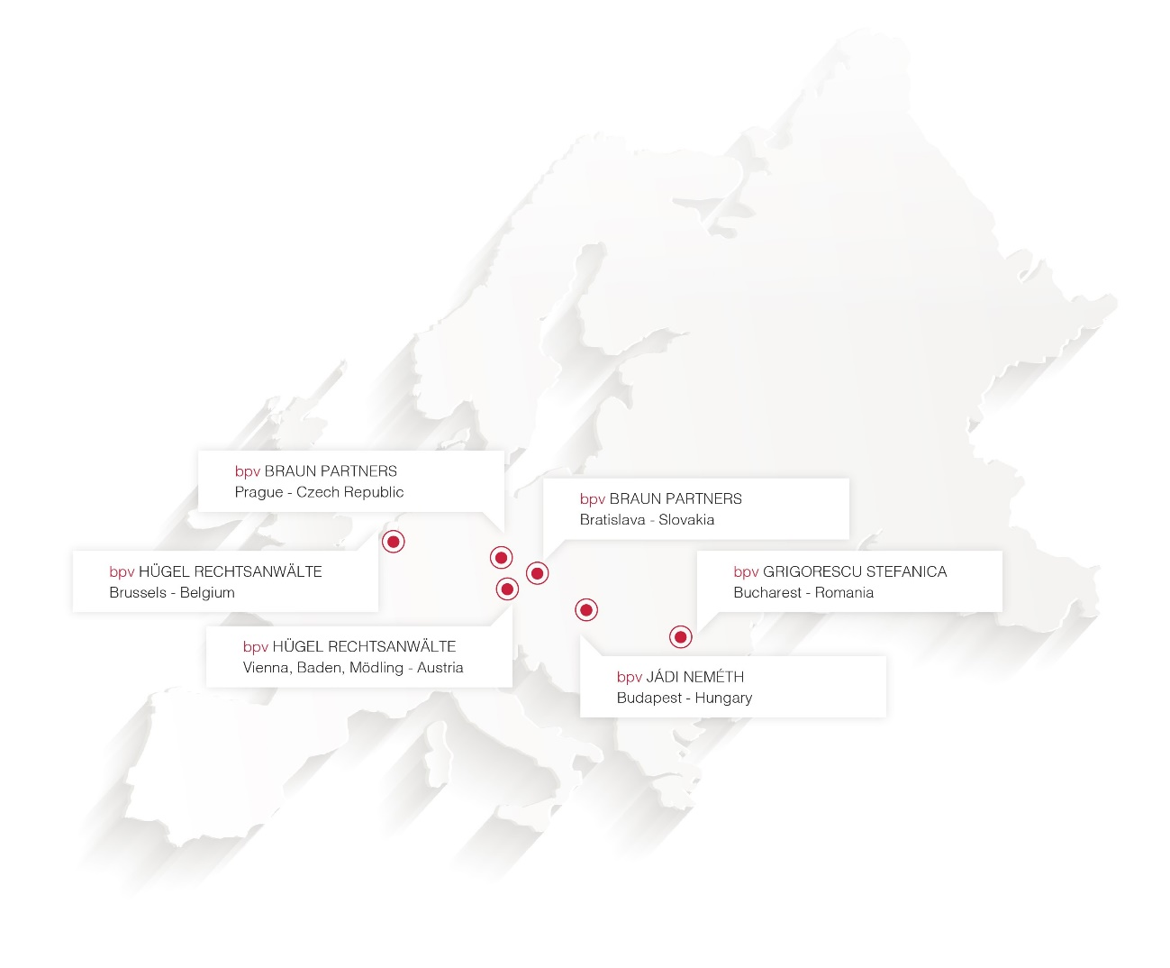
About bpv BRAUN PARTNERS / bpv LEGAL
The core of the bpv BRAUN PARTNERS team has been together since 1994, then as part of a leading international law and tax firm of German origin (Haarmann Hemmelrath). Our lawyers and tax advisers have supported hundreds of western clients in their first steps in the Czech Republic and Slovakia, and we are grateful that we can continue the cooperation with many of these clients to this day.
Our advisory work includes not only advising on significant transactions, and therefore making the newspaper headlines, but also finding the solution to business problems in everyday life. Beginning with the construction of a new production line, service location, or sales structure, our aim is always to work with our clients and help them achieve their business goals.
Our clients are entrepreneurs like us – we advise them to the highest possible standards not only because we are professionals, but also because we ourselves think like businessmen.
We combine the advantages of an international full-service law firm such as practical experience, professional employees, international network and continuous training with the flexibility, service orientation and knowledge of the national market of a local law firm. Together with our friends from bpv LEGAL we cover the entire CEE region. bpv LEGAL is a co-operation of four independent law firms in CEE, founded in 2006 with currently over 140 lawyers.
Austria 40 lawyers 3 tax advisors
Belgium 2 lawyers
Czech Republic 38 lawyers 1 tax advisor
Hungary 15 lawyers
Romania 37 lawyers
Slovakia 7 lawyers

Slide 18
Rankings

